Slide 1
Overview of Cryptographic Techniques
Hector M Lugo-Cordero
CIS 4361
Secure Operating System Administration

Slide 2
Resources Used
Lecture slides from Dr Ratan Guha CNT 6519 Wireless Security Forensics
Cryptography and Network Security, Fourth Edition, by William Stallings
Lecture slides for the textbook by Lawrie Brown
Lecture slides by Henric Johnson,Blekinge Institute of Technology, Sweden

Slide 3
Outline
Some Basic Terminology
Conventional Encryption Principles
Characteristics of Cryptographic Techniques
Symmetric Encryption
Classical Symmetric Encryption Algorithms
Modern Symmetric Encryption Techniques

Slide 4
Some Basic Terminology
plaintext - original message
ciphertext - coded message
cipher - algorithm for transforming plaintext to ciphertext
key - info used in cipher known only to sender/receiver
encipher (encrypt) - converting plaintext to ciphertext
decipher (decrypt) - recovering ciphertext from plaintext
cryptography - study of encryption principles/methods
cryptanalysis (codebreaking) - study of principles/ methods of deciphering ciphertext without knowing key
cryptology - field of both cryptography and cryptanalysis
Notes:
Briefly review some terminology used throughout the course.

Slide 5
Conventional Encryption Principles
An encryption scheme has five ingredients:
  Plaintext
  Encryption algorithm
  Secret Key
  Ciphertext
  Decryption algorithm
Security depends on the secrecy of the key, not the secrecy of the algorithm

Slide 6
Characteristics of Cryptographic Techniques
Classified along three independent dimensions:
  The type of operations used for transforming plaintext to ciphertext
  The number of keys used
    symmetric (single key)
    asymmetric (two-keys, or public-key encryption)
  The way in which the plaintext is processed

Slide 7
Symmetric Encryption
or conventional / private-key / single-key
sender and recipient share a common key
all classical encryption algorithms are private-key
was only type prior to invention of public-key in 1970’s
and by far most widely used
Notes:
Symmetric encryption, also referred to as conventional encryption or single-key encryption, was the only type of encryption in use prior to the development of public-key encryption in the 1970s. It remains by far the most widely used of the two types of encryption. All traditional schemes are symmetric / single key / private-key encryption algorithms, with a single key, used for both encryption and decryption. Since both sender and receiver are equivalent, either can encrypt or decrypt messages using that common key.

Slide 8

Symmetric Cipher Model
Notes:
Detail the five ingredients of the symmetric cipher model, shown in Stallings Figure 2.1:
plaintext - original message
encryption algorithm – performs substitutions/transformations on plaintext
secret key – control exact substitutions/transformations used in encryption algorithm
ciphertext - scrambled message
decryption algorithm – inverse of encryption algorithm

Slide 9
Requirements
two requirements for secure use of symmetric encryption:
  a strong encryption algorithm
  a secret key known only to sender / receiver
mathematically have:
  Y = E_{K}(X) [= E(K, X) ]
  X = D_{K}(Y) [= D(K, Y) ]
assume encryption algorithm is known
implies a secure channel to distribute key
Notes:
We assume that it is impractical to decrypt a message on the basis of the cipher- text plus knowledge of the encryption/decryption algorithm, and do not need to keep the algorithm secret; rather we only need to keep the key secret. This feature of symmetric encryption is what makes it feasible for widespread use. It allows easy distribution of s/w and h/w implementations.
Can take a closer look at the essential elements of a symmetric encryption scheme: mathematically it can be considered a pair of functions with: plaintext X, ciphertext Y, key K, encryption algorithm E_{K}, decryption algorithm D_{K}.

Slide 10
Brute Force Search
always possible to simply try every key
most basic attack, proportional to key size
assume either know / recognize plaintext
Key Size (bits) | Number of Alternative Keys | Time required at 1 decryption/µs | Time required at 10⁶ decryptions/µs
32 | 2³² = 4.3 × 10⁹ | 2³¹ µs = 35.8 minutes | 2.15 milliseconds
56 | 2⁵⁶ = 7.2 × 10¹⁶ | 2⁵⁵ µs = 1142 years | 10.01 hours
128 | 2¹²⁸ = 3.4 × 10³⁸ | 2¹²⁷ µs = 5.4 × 10²⁴ years | 5.4 × 10¹⁸ years
168 | 2¹⁶⁸ = 3.7 × 10⁵⁰ | 2¹⁶⁷ µs = 5.9 × 10³⁶ years | 5.9 × 10³⁰ years
26 characters (permutation) | 26! = 4 × 10²⁶ | 2 × 10²⁶ µs = 6.4 × 10¹² years | 6.4 × 10⁶ years
Notes:
A brute-force attack involves trying every possible key until an intelligible translation of the ciphertext into plaintext is obtained. On average, half of all possible keys must be tried to achieve success. Stallings Table 2.2 shows how much time is required to conduct a brute-force attack, for various common key sizes (DES is 56, AES is 128, Triple-DES is 168, plus general mono-alphabetic cipher), where either a single system or a million parallel systems, are used.

Slide 11
Classical Substitution Ciphers
where letters of plaintext are replaced by other letters or by numbers or symbols
or if plaintext is viewed as a sequence of bits, then substitution involves replacing plaintext bit patterns with ciphertext bit patterns
Notes:
In this section and the next, we examine a sampling of what might be called classical encryption techniques. A study of these techniques enables us to illustrate the basic approaches to symmetric encryption used today and the types of cryptanalytic attacks that must be anticipated. The two basic building blocks of all encryption technique are substitution and transposition. We examine these in the next two sections. Finally, we discuss a system that combine both substitution and transposition.

Slide 12
Caesar Cipher
earliest known substitution cipher
by Julius Caesar
first attested use in military affairs
replaces each letter by 3rd letter after
example:
  meet me after the toga party
  PHHW PH DIWHU WKH WRJD SDUWB
Notes:
Substitution ciphers form the first of the fundamental building blocks. The core idea is to replace one basic unit (letter/byte) with another. Whilst the early Greeks described several substitution ciphers, the first attested use in military affairs of one was by Julius Caesar, described by him in Gallic Wars (cf. Kahn pp83-84). Still call any cipher using a simple letter shift a caesar cipher, not just those with shift 3.

Slide 13
Caesar Cipher
can define transformation as:
  a b c d e f g h i j k l m n o p q r s t u v w x y z
  D E F G H I J K L M N O P Q R S T U V W X Y Z A B C
mathematically give each letter a number
  a b c d e f g h i j k l m n o p q r s t u v w x y z
  0 1 2 3 4 5 6 7 8 9 10 11 12 13 14 15 16 17 18 19 20 21 22 23 24 25
then have Caesar cipher as:
  c = E(p) = (p + k) mod (26)
  p = D(c) = (c – k) mod (26)
Notes:
This mathematical description uses modulo (clock) arithmetic. Here, when you reach Z you go back to A and start again. Mod 26 implies that when you reach 26, you use 0 instead (ie the letter after Z, or 25 + 1 goes to A or 0).
Example: howdy (7,14,22,3,24) encrypted using key f (ie a shift of 5) is MTBID

Slide 14
Monoalphabetic Cipher
rather than just shifting the alphabet
could shuffle (jumble) the letters arbitrarily
each plaintext letter maps to a different random ciphertext letter
hence key is 26 letters long
  Plain: abcdefghijklmnopqrstuvwxyz
  Cipher: DKVQFIBJWPESCXHTMYAUOLRGZN
  Plaintext: ifwewishtoreplaceletters
  Ciphertext: WIRFRWAJUHYFTSDVFSFUUFYA
Notes:
With only 25 possible keys, the Caesar cipher is far from secure. A dramatic increase in the key space can be achieved by allowing an arbitrary substitution, where the translation alphabet can be any permutation of the 26 alphabetic characters.
See example translation alphabet, and an encrypted message using it.

Slide 15
Playfair Cipher
not even the large number of keys in a monoalphabetic cipher provides security
one approach to improving security was to encrypt multiple letters
the Playfair Cipher is an example
invented by Charles Wheatstone in 1854, but named after his friend Baron Playfair
Notes:
Consider ways to reduce the "spikyness" of natural language text, since if just map one letter always to another, the frequency distribution is just shuffled. One approach is to encrypt more than one letter at once. The Playfair cipher is an example of doing this.

Slide 16
Playfair Key Matrix
a 5X5 matrix of letters based on a keyword
fill in letters of keyword (minus duplicates)
fill rest of matrix with other letters
eg. using the keyword MONARCHY
M | O | N | A | R
C | H | Y | B | D
E | F | G | I/J | K
L | P | Q | S | T
U | V | W | X | Z
Notes:
The best-known multiple-letter encryption cipher is the Playfair, which treats digrams in the plaintext as single units and translates these units into ciphertext digrams. The Playfair algorithm is based on the use of a 5x5 matrix of letters constructed using a keyword. The rules for filling in this 5x5 matrix are: L to R, top to bottom, first with keyword after duplicate letters have been removed, and then with the remain letters, with I/J used as a single letter. This example comes from Dorothy Sayer's book "Have His Carcase", in which Lord Peter Wimsey solves it, and describes the use of a probably word attack.

Slide 17
Encrypting and Decrypting
plaintext is encrypted two letters at a time
  if a pair is a repeated letter, insert filler like 'X’ (low probability of appearance in language)
  if both letters fall in the same row, replace each with letter to right (wrapping back to start from end)
  if both letters fall in the same column, replace each with the letter below it (again wrapping to top from bottom)
  otherwise each letter is replaced by the letter in the same row and in the column of the other letter of the pair
Wireless Wi re le sx sz XG MK UL XA XT
Notes:
Plaintext is encrypted two letters at a time,according to the rules as shown. Note how you wrap from right side back to left, or from bottom back to top.
if a pair is a repeated letter, insert a filler like 'X', eg. "balloon" encrypts as "ba lx lo on"
if both letters fall in the same row, replace each with letter to right (wrapping back to start from end), eg. “ar" encrypts as "RM"
if both letters fall in the same column, replace each with the letter below it (again wrapping to top from bottom), eg. “mu" encrypts to "CM"
otherwise each letter is replaced by the one in its row in the column of the other letter of the pair, eg. “hs" encrypts to "BP", and “ea" to "IM" or "JM" (as desired)
Decrypting of course works exactly in reverse. Can see this by working the example pairs shown, backwards.

Slide 18
Polyalphabetic Ciphers
polyalphabetic substitution ciphers
A set of related monoalphabetic substitution rules is used
use a key to select which alphabet is used for each letter of the message
use each alphabet in turn
repeat from start after end of key is reached
make cryptanalysis harder with more alphabets to guess and flatter frequency distribution
Key: deceptive 3 4 2 4 15 19 8 21 4
plaintext: wireless 22 8 17 4 11 4 18 18
ciphertext: zmtiaxao 25 12 19 8 26 23 26 39
Notes:
One approach to reducing the "spikyness" of natural language text is used the Playfair cipher which encrypts more than one letter at once. We now consider the other alternative, using multiple cipher alphabets in turn. This gives the attacker more work, since many alphabets need to be guessed, and because the frequency distribution is more complex, since the same plaintext letter could be replaced by several ciphertext letters, depending on which alphabet is used. The general name for this approach is a polyalphabetic substitution cipher. All these techniques have the following features in common:
A set of related monoalphabetic substitution rules is used.
2. A key determines which particular rule is chosen for a given transformation.

Slide 19
Vigenère Cipher
simplest polyalphabetic substitution cipher
effectively multiple caesar ciphers
key is multiple letters long K = k₁ k₂ ... k_{d}
i^{th} letter specifies i^{th} alphabet to use
use each alphabet in turn
repeat from start after d letters in message
decryption simply works in reverse
Notes:
The best known, and one of the simplest, such algorithms is referred to as the Vigenère cipher, where the set of related monoalphabetic substitution rules consists of the 26 Caesar ciphers, with shifts of 0 through 25. Each cipher is denoted by a key letter, which is the ciphertext letter that substitutes for the plaintext letter ‘a’, and which are each used in turn, as shown next.

Slide 20
Example of Vigenère Cipher
write the plaintext out
write the keyword repeated above it
use each key letter as a caesar cipher key
encrypt the corresponding plaintext letter
eg using keyword deceptive
  key: deceptivedeceptivedeceptive
  plaintext: wearediscoveredsaveyourself
  ciphertext:ZICVTWQNGRZGVTWAVZHCQYGLMGJ
Notes:
Discuss this simple example from text Stallings section 2.2.

Slide 21
Vernam Cipher and One-time Pad
Keyword is as long as the plaintext and has no statistical relationship to it.
Vernam system works on binary data with ith bit of text exclusive ored with ith bit of key to produce ith bit of cipher
In one one-time pad key is used only once
This scheme is unbreakable

Slide 22
Transposition Cipher
Mapping is performed by some sort of permutation on the plaintext letters.
Example: Rail fence of depth 2
text : meet me after the toga party
m e m a t r h t g p r y
e t e f e t e o a a t
cipher: MEMATRHTGPRYETEFETEOAAT
Rail fence of depth 2

Slide 23
Classical Ciphers
Caesar Cipher
Monoalphabetic Cipher
Playfair Cipher
Polyphabetic Cipher
Vigenère Cipher
Vernam Cipher and One-time Pad
Transposition Cipher
Cryptography -Part -I

Slide 24
Modern Block Ciphers
now look at modern block ciphers
one of the most widely used types of cryptographic algorithms
provide secrecy /authentication services
focus on DES (Data Encryption Standard)
to illustrate block cipher design principles
Notes:
Modern block ciphers are widely used to provide encryption of quantities of information, and/or a cryptographic checksum to ensure the contents have not been altered. We continue to use block ciphers because they are comparatively fast, and because we know a fair amount about how to design them. Will use the widely known DES algorithm to illustrate some key block cipher design principles.

Slide 25
Block vs Stream Ciphers
block ciphers process messages in blocks, each of which is then en/decrypted
like a substitution on very big characters
  64-bits or more
stream ciphers process messages a bit or byte at a time when en/decrypting
many current ciphers are block ciphers
broader range of applications
Notes:
Block ciphers work a on block / word at a time, which is some number of bits. All of these bits have to be available before the block can be processed. Stream ciphers work on a bit or byte of the message at a time, hence process it as a “stream”. Block ciphers are currently better analysed, and seem to have a broader range of applications, hence focus on them.

Slide 26
Block Cipher Principles
most symmetric block ciphers are based on a Feistel Cipher Structure
needed since must be able to decrypt ciphertext to recover messages efficiently
block ciphers look like an extremely large substitution
would need table of 2⁶⁴ entries for a 64-bit block
instead create from smaller building blocks
using idea of a product cipher
Notes:
Most symmetric block encryption algorithms in current use are based on a structure referred to as a Feistel block cipher. A block cipher operates on a plaintext block of n bits to produce a ciphertext block of n bits. An arbitrary reversible substitution cipher for a large block size is not practical, however, from an implementation and performance point of view. In general, for an n-bit general substitution block cipher, the size of the key is n x 2^{n}. For a 64-bit block, which is a desirable length to thwart statistical attacks, the key size is 64 x 2⁶⁴ = 2⁷⁰ = 10²¹ bits. In considering these difficulties, Feistel points out that what is needed is an approximation to the ideal block cipher system for large n, built up out of components that are easily realizable.

Slide 27

Ideal Block Cipher
Notes:
Feistel refers to an n-bit general substitution as an ideal block cipher, because it allows for the maximum number of possible encryption mappings from the plaintext to ciphertext block. A 4-bit input produces one of 16 possible input states, which is mapped by the substitution cipher into a unique one of 16 possible output states, each of which is represented by 4 ciphertext bits. The encryption and decryption mappings can be defined by a tabulation, as shown in Stallings Figure 3.1. It illustrates a tiny 4-bit substitution to show that each possible input can be arbitrarily mapped to any output - which is why its complexity grows so rapidly.

Slide 28
Claude Shannon and Substitution-Permutation Ciphers
Claude Shannon introduced idea of substitution-permutation (S-P) networks in 1949 paper
form basis of modern block ciphers
S-P nets are based on the two primitive cryptographic operations seen before:
  substitution (S-box)
  permutation (P-box)
provide confusion & diffusion of message & key
Notes:
Claude Shannon’s 1949 paper has the key ideas that led to the development of modern block ciphers. Critically, it was the technique of layering groups of S-boxes separated by a larger P-box to form the S-P network, a complex form of a product cipher. He also introduced the ideas of confusion and diffusion, notionally provided by S-boxes and P-boxes (in conjunction with S-boxes).

Slide 29
Confusion and Diffusion
cipher needs to completely obscure statistical properties of original message
a one-time pad does this
more practically Shannon suggested combining S & P elements to obtain:
diffusion – dissipates statistical structure of plaintext over bulk of ciphertext
confusion – makes relationship between ciphertext and key as complex as possible
Notes:
The terms diffusion and confusion were introduced by Claude Shannon to capture the two basic building blocks for any cryptographic system. Every block cipher involves a transformation of a block of plaintext into a block of ciphertext, where the transformation depends on the key. The mechanism of diffusion seeks to make the statistical relationship between the plaintext and ciphertext as complex as possible in order to thwart attempts to deduce the key. Confusion seeks to make the relationship between the statistics of the ciphertext and the value of the encryption key as complex as possible, again to thwart attempts to discover the key.
So successful are diffusion and confusion in capturing the essence of the desired attributes of a block cipher that they have become the cornerstone of modern block cipher design.

Slide 30
Feistel Cipher Structure
Horst Feistel devised the feistel cipher
  based on concept of invertible product cipher
partitions input block into two halves
  process through multiple rounds which
  perform a substitution on left data half
  based on round function of right half & subkey
  then have permutation swapping halves
implements Shannon’s S-P net concept
Notes:
Horst Feistel, working at IBM Thomas J Watson Research Labs devised a suitable invertible cipher structure in early 70's.
One of Feistel's main contributions was the invention of a suitable structure which adapted Shannon's S-P network in an easily inverted structure. It partitions input block into two halves which are processed through multiple rounds which perform a substitution on left data half, based on round function of right half & subkey, and then have permutation swapping halves. Essentially the same h/w or s/w is used for both encryption and decryption, with just a slight change in how the keys are used. One layer of S-boxes and the following P-box are used to form the round function.

Slide 31
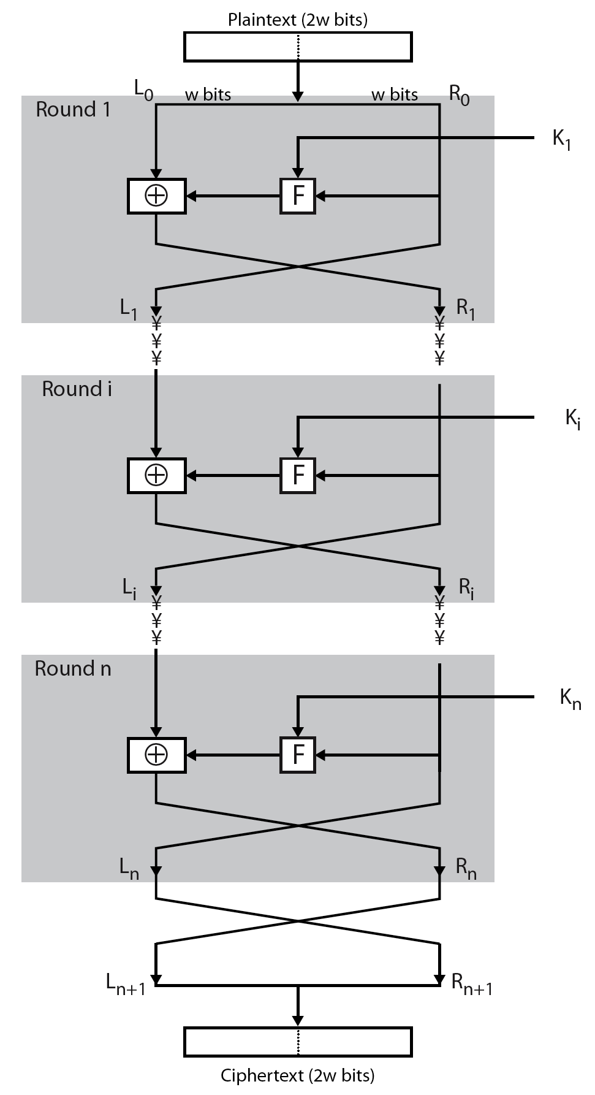
Feistel Cipher Structure
Notes:
Stallings Figure 3.2 illustrates the classical feistel cipher structure, with data split in 2 halves, processed through a number of rounds which perform a substitution on left half using output of round function on right half & key, and a permutation which swaps halves, as listed previously.

Slide 32
Feistel Cipher Design Elements
block size
key size
number of rounds
subkey generation algorithm
round function
fast software en/decryption
ease of analysis
Notes:
The exact realization of a Feistel network depends on the choice of the following parameters and design features:
block size - increasing size improves security, but slows cipher
key size - increasing size improves security, makes exhaustive key searching harder, but may slow cipher
number of rounds - increasing number improves security, but slows cipher
subkey generation algorithm - greater complexity can make analysis harder, but slows cipher
round function - greater complexity can make analysis harder, but slows cipher
fast software en/decryption - more recent concern for practical use
ease of analysis - for easier validation & testing of strength

Slide 33
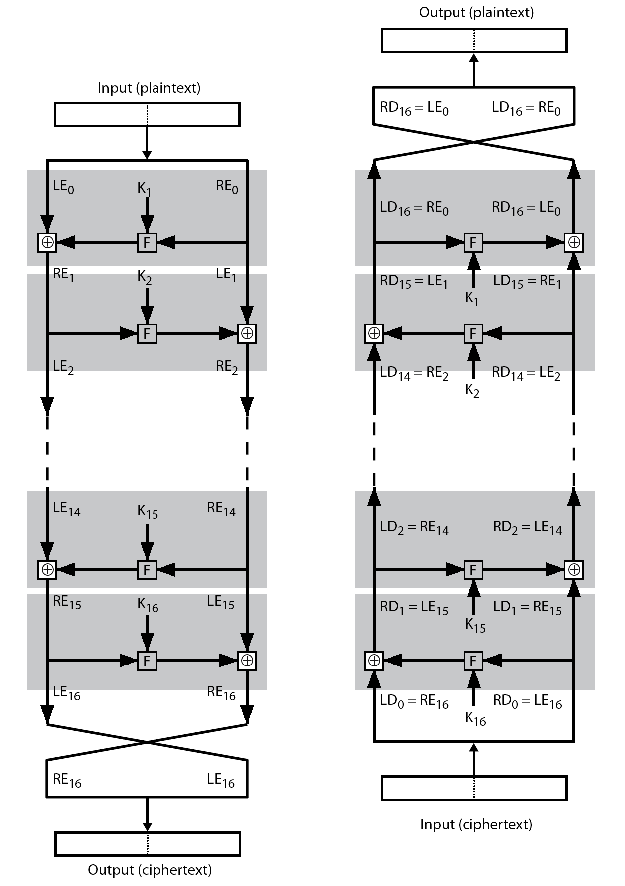
Feistel Cipher Encryption & Decryption
Notes:
The process of decryption with a Feistel cipher, as shown in Stallings Figure 3.3, is essentially the same as the encryption process. The rule is as follows: Use the ciphertext as input to the algorithm, but use the subkeys Ki in reverse order. That is, use Kn in the first round, Kn–1 in the second round, and so on until K1 is used in the last round. This is a nice feature because it means we need not implement two different algorithms, one for encryption and one for decryption.

